Slide 1
MIS
CHAPTER 3
DATABASE SYSTEMS, DATA WAREHOUSES, AND DATA MARTS
Hossein BIDGOLI

Slide 2
Chapter 3 Database Systems, Data Warehouses, and Data Marts
l e a r n i n g o u t c o m e s
LO1 Define a database and a database management system.
LO2 Explain logical database design and the relational database model.
LO3 Define the components of a database management system.
LO4 Summarize recent trends in database design and use.
LO5 Explain the components and functions of a data warehouse.

Slide 3
Chapter 3 Database Systems, Data Warehouses, and Data Marts
l e a r n i n g o u t c o m e s (cont’d.)
LO6 Describe the functions of a data mart.

Slide 4
Databases
Database
  Collection of related data that can be stored in a central location or in multiple locations
  Usually a group of files
File
  Group of related records
  All files are integrated
Record
  Group of related fields
Data hierarchy

Slide 5
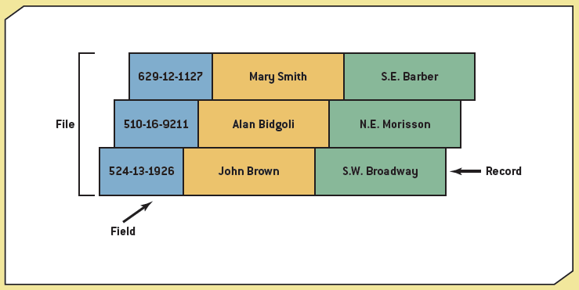
Exhibit 3.1
Data Hierarchy

Slide 6
Databases (cont’d.)
Critical component of information systems
  Any type of analysis that’s done is based on data available in the database
Database management system (DBMS)
  Creating, storing, maintaining, and accessing database files
Advantages over a flat file system

Slide 7
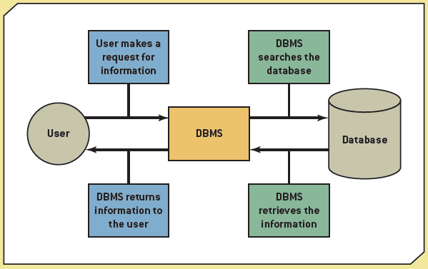
Exhibit 3.2
Interaction between the User, DBMC, and Database

Slide 8
Types of Data in a Database
Internal data
  Collected within organization
External data
  Sources

Slide 9
BI in Action: Law Enforcement
Business intelligence (BI)
  Used in law enforcement as well as in the business world
Richmond, Virginia
  System generates BI reports that help pinpoint crime patterns
  Allocate manpower to days and locations where crime likely to occur

Slide 10
Methods for Accessing Files
Sequential file structure
  Records organized and processed in numerical or sequential order
  Organized based on a “primary key”
  Usually used for backup and archive files
    Because they need updating only rarely
Random access file structure
  Records can be accessed in any order
  Fast and very effective when a small number of records need to be processed daily or weekly

Slide 11
Methods for Accessing Files (cont’d.)
Indexed sequential access method (ISAM)
  Records accessed sequentially or randomly
  Depending on the number being accessed
Indexed access
  Uses an index structure with two parts:
    Indexed value
    Pointer to the disk location of the record matching the indexed value

Slide 12
Logical Database Design
Physical view
  How data is stored on and retrieved from storage media
Logical view
  How information appears to users
  How it can be organized and retrieved
  Can be more than one logical view

Slide 13
Logical Database Design (cont’d.)
Data model
  Determines how data is created, represented, organized
  Includes:
    Data structure
    Operations
    Integrity rules
Hierarchical model
  Relationships between records form a treelike structure

Slide 14
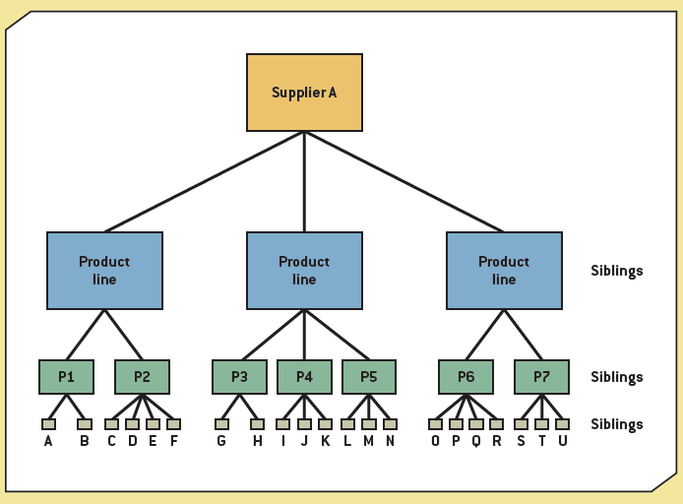
Exhibit 3.3
A Hierarchical Model

Slide 15
Logical Database Design (cont’d.)
Network model
  Similar to the hierarchical model
  Records are organized differently

Slide 16
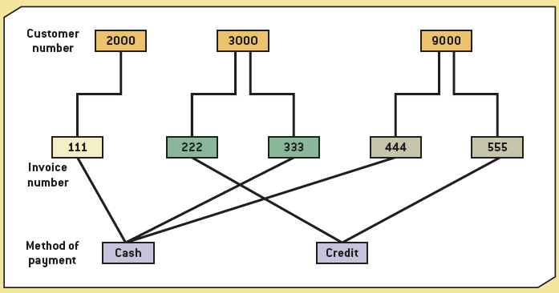
Exhibit 3.4
A Network Model

Slide 17
The Relational Model
Relational model
  Uses a two-dimensional table of rows and columns of data
Data dictionary
  Field name
  Field data type
  Default value
  Validation rule

Slide 18
The Relational Model (cont’d.)
Primary key
  Unique identifier
Foreign key
  Establishes relationships between tables
Normalization
  Improves database efficiency
  Eliminates redundant data
  1NF through 3NF (or 5NF)

Slide 19
The Relational Model (cont’d.)
Data retrieval
  Select
  Project
  Join
  Intersection
  Union
  Difference

Slide 20
Components of a DBMS
Database engine
Data definition
Data manipulation
Application generation
Data administration

Slide 21
Database Engine
Heart of DBMS software
Responsible for data storage, manipulation, and retrieval
Converts logical requests from users into their physical equivalents

Slide 22
Data Definition
Create and maintain the data dictionary
Define the structure of files in a database
  Adding fields
  Deleting fields
  Changing field size
  Changing data type

Slide 23
Data Manipulation
Add, delete, modify, and retrieve records from a database
Query language
  Structured Query Language (SQL)
    Standard fourth-generation query language used by many DBMS packages
    SELECT statement
  Query by example (QBE)
    Construct statement of query forms
    Graphical interface

Slide 24
Application Generation
Design elements of an application using a database
  Data entry screens
  Interactive menus
  Interfaces with other programming languages

Slide 25
Data Administration
Used for:
  Backup and recovery
  Security
  Change management
Create, read, update, and delete (CRUD)
Database administrator (DBA)
  Individual or department
  Responsibilities

Slide 26
Recent Trends in Database Design and Use
Data-driven Web sites
Natural language processing
Distributed databases
Client/server databases
Object-oriented databases

Slide 27
Data-Driven Web Sites
Data-driven Web site
  Interface to a database
  Retrieves data and allows users to enter data
Improves access to information
Useful for:
  E-commerce sites that need frequent updates
  News sites that need regular updating of content
  Forums and discussion groups
  Subscription services, such as newsletters

Slide 28
Distributed Databases
Distributed database
  Data is stored on multiple servers placed throughout an organization
Reasons for choosing
Approaches for setup
  Fragmentation
  Replication
  Allocation
Security issues

Slide 29
Client/Server Databases
Client/server database
  Users’ workstations (clients) linked in a local area network (LAN) to share the services of a single server
  Server processes data
  Returns only records meeting request

Slide 30
Object-Oriented Databases
Object-oriented database
  Object consists of attributes and methods
Encapsulation
  Grouping objects along with their attributes and methods into a class
Inheritance
  New objects can be created faster and more easily by entering new data in attributes
Interaction with an object-oriented database takes places via methods

Slide 31
Data Warehouses
Data warehouse
  Collection of data used to support decision-making applications and generate business intelligence
Multidimensional data
Characteristics
  Subject oriented
  Integrated
  Time variant
  Type of data
  Purpose

Slide 32
Input
Variety of sources
  External
  Databases
  Transaction files
  ERP systems
  CRM systems

Slide 33
ETL
Extraction, transformation, and loading (ETL)
Extraction
  Collecting data from a variety of sources
  Converting data into a format that can be used in transformation processing
Transformation processing
  Make sure data meets the data warehouse’s needs
Loading
  Process of transferring data to the data warehouse

Slide 34
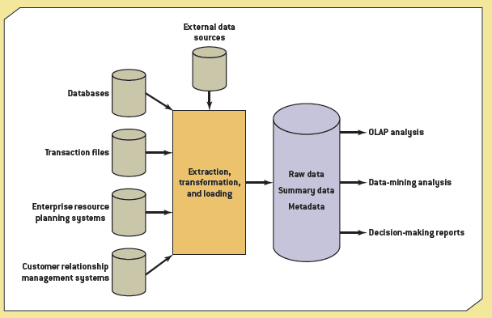
Exhibit 3.9
A Data Warehouse Configuration

Slide 35
Storage
Raw data
Summary data
Metadata

Slide 36
Output
Data warehouse supports different types of analysis
  Generates reports for decision making
Online analytical processing (OLAP)
  Generates business intelligence
  Uses multiple sources of information and provides multidimensional analysis
  Hypercube
  Drill down and drill up

Slide 37
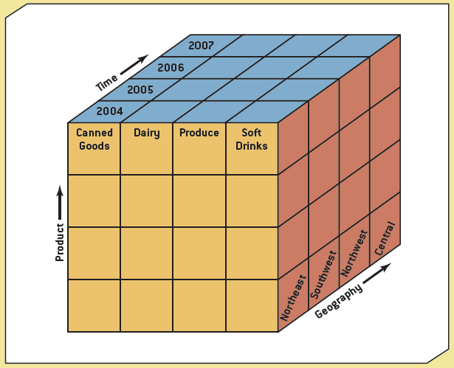
Exhibit 3.10
Slicing and Dicing Data

Slide 38
Output (cont’d.)
Data-mining analysis
  Discover patterns and relationships
Reports
  Cross-reference segments of an organization’s operations for comparison purposes
  Find patterns and trends that can’t be found with databases
  Analyze large amounts of historical data quickly

Slide 39
Data Warehouse Applications at InterContinental Hotels Group (IHG)
The new system has increased the company’s query response time from hours to minutes
It has generated valuable BI on both its customers and the competition
Future plans include the migration of financial data, which will enable IHG to perform side-by-side analyses of operations, marketing, sales, and financial data

Slide 40
Data Marts
Data mart
  Smaller version of data warehouse
  Used by single department or function
Advantages over data warehouses
More limited scope than data warehouses

Slide 41
Summary
Databases
  Accessing files
  Design principles
  Components
  Recent trends
Data warehouses and data marts

